Slide 1
Molecular Modeling
Computational Chemistry
Shapes Lewis Structures
http://molview.org
Covalent Bonds:
Lewis Structures, Molecular Shapes
Dr. Ron Rusay

Slide 2
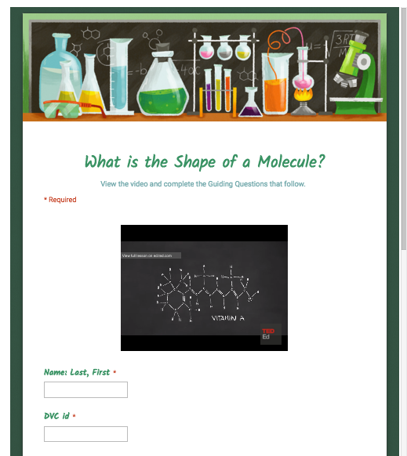

Shapes of Molecules
https://www.youtube.com/watch?v=Jq_Ca-HKh1g
View: What is the shape of a molecule?
George Zaidan and Charles Morton
http://chemconnections.org/general/chem108/Molecular%252520Shapes-Guide.html

Slide 3
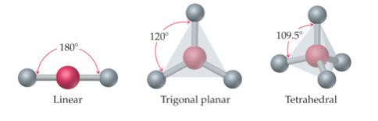
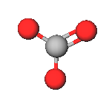
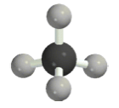
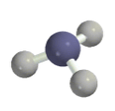
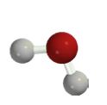
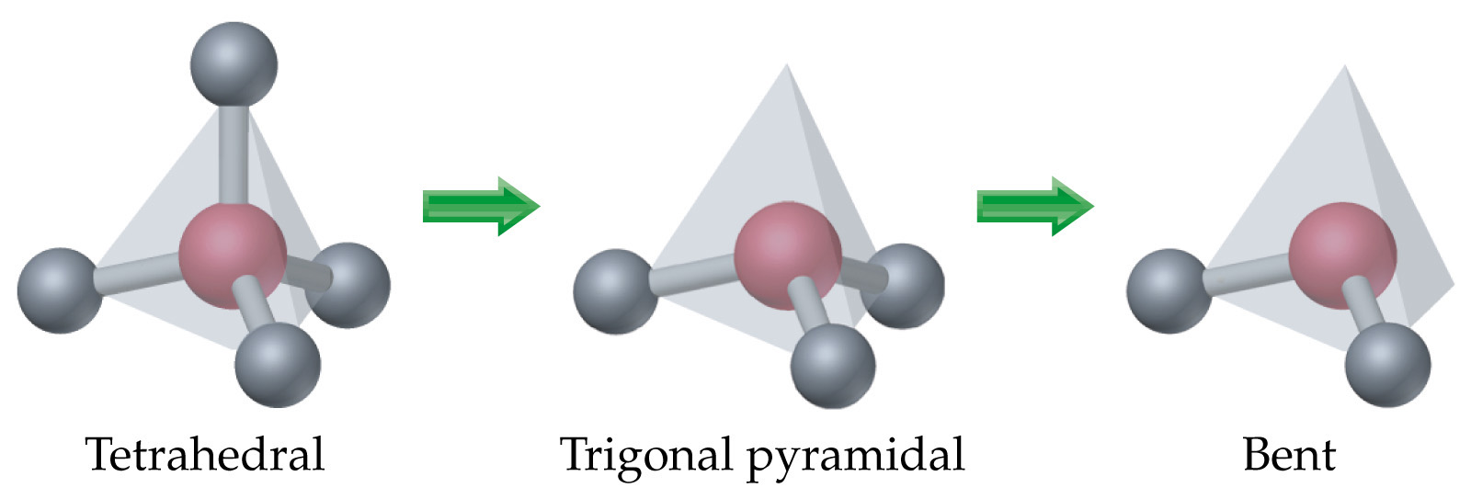
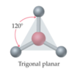
Molecular Shapes
Molecular Models for C, H, N, O
Fundamental repeating shapes found in every biological and synthetically made organic molecule including plastics
C =black
H = gray
N = blue
O = red
pink = generic atom

Slide 4
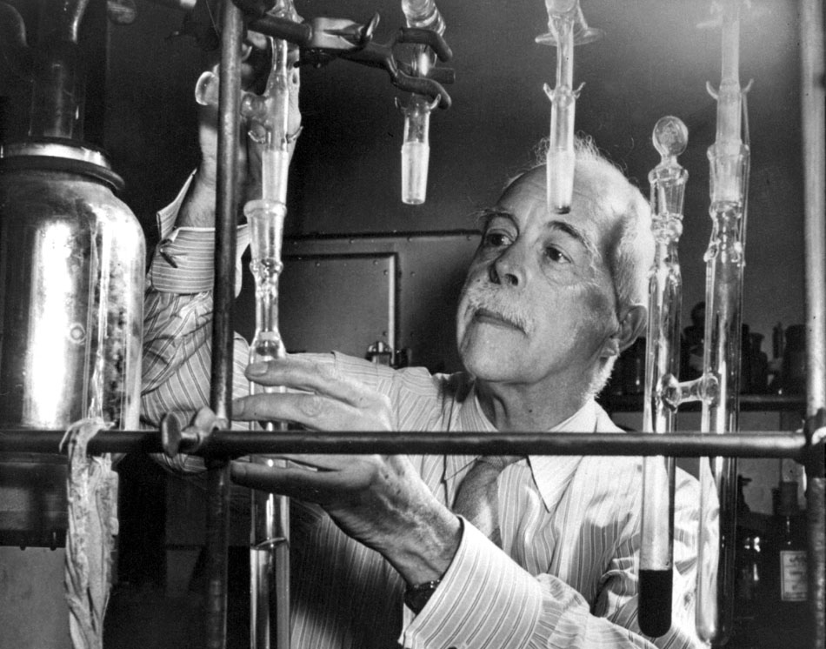
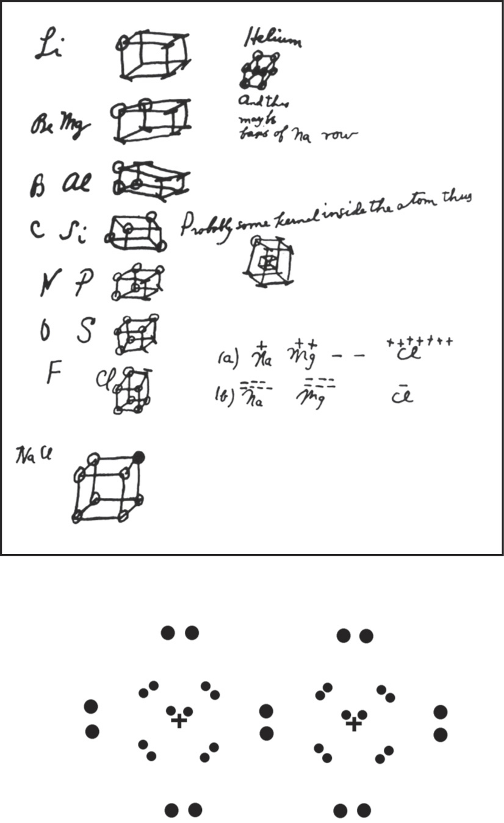
Professor Gilbert Newton Lewis (circa 1940)
G.N. Lewis
Photo Bancroft Library, University of California/LBNL Image Library
Footnote:
G.N. Lewis, despite his insight and contributions to chemistry, was never awarded the Nobel prize.
Notes from Lewis’s notebook
and his “Lewis” structure.

Slide 5
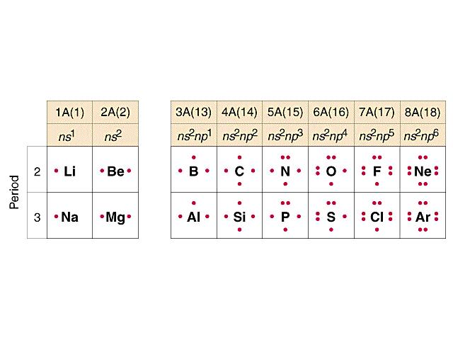



Valence Electrons – Lewis Dot Drawings
A Groups-Periods 2 & 3
.H

Slide 6

Covalent Bond Numbers
(Neutral Atoms!)
.H
one bond
H
F
Cl
Br
I
..
two bonds
:
O
..
three bonds
N
four bonds
C

Slide 7
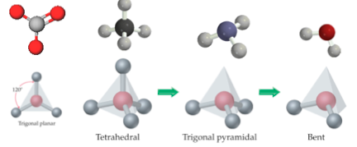
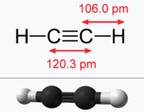
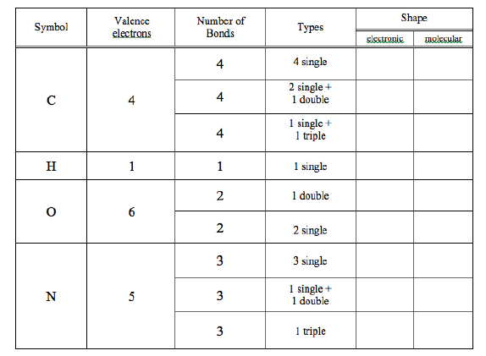
Linear
Trigonal Planar Tetrahedral Trigonal Pyramidal Bent
Molecular Models
[Handout]
(Handout)
..
..
molecular shape
:
“electronic”=”VSEPR” shape
includes the electron pairs
(VSEPR: Electron Domain)
Linear
Trigonal Planar Tetrahedral Tetrahedral Tetrahedral
http://chemconnections.org/general/chem108/Molecular%20Modeling-intro%20%26%20table%202019f.pdf

Slide 8
Linear
Trigonal Planar Tetrahedral Trigonal Pyramidal Bent
Molecular Models
[Handout]
(Handout)
..
..
molecular shape
:
“electronic”=”VSEPR” shape
includes the electron pairs
(VSEPR: Electron Domain)
Linear
Trigonal Planar Tetrahedral Tetrahedral Tetrahedral
carbon-carbon
bond lengths
Single
longest length
T
TPl
L
L
TPl
T
T
TPl
L
T
TPl
L
L
L
B
TPy
B
L
Double
shorter length
Linear = L
Trigonal Planar = TPl
Tetrahedral =T
Trigonal Pyramidal =TPy
Bent = B
Triple
shortest length
Due End of Lab Next Week
http://chemconnections.org/general/chem108/Molecular%20Modeling-intro%20%26%20table%202019f.pdf

Slide 9
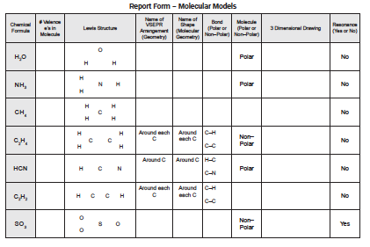
Lewis Structures Molecular Shapes
http://molview.org
Name?
8
Ammonia
Molecular Modeling: Bonding & Lewis Structures
Computational Chemistry: Molecular Modeling Report Form

Slide 10




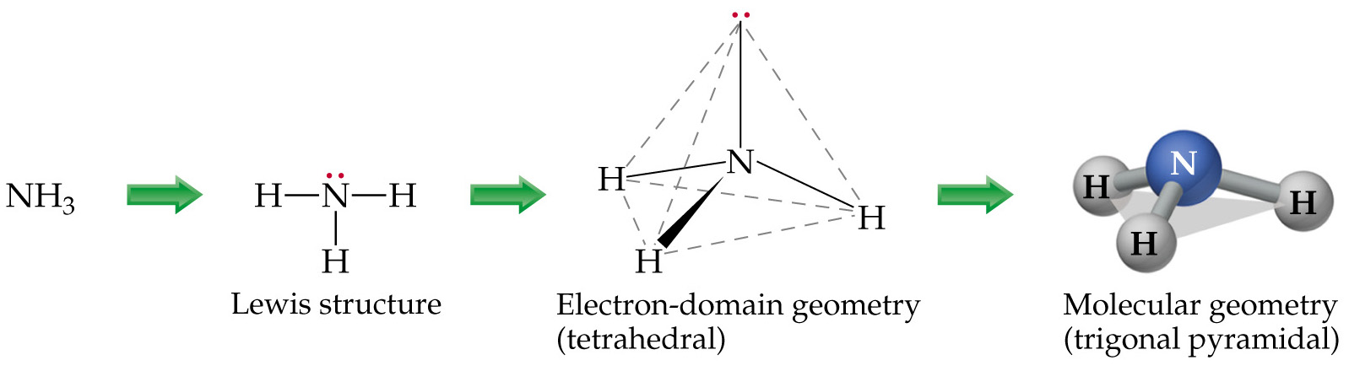
Lewis Structures Molecular Shapes
For simple Lewis structures:
  Draw the individual atoms using dots to represent the valence electrons.
  Put the atoms together so they share PAIRS of electrons to make complete octets.
NH₃, for example:
Eg. Ammonia:

Slide 11

Molecular Shapes Lewis Structures
http://molview.org
optional
Name?
8
Ammonia
Molecular Modeling: Bonding & Lewis Structures
Computational Chemistry: Molecular Modeling Report Form

Slide 12
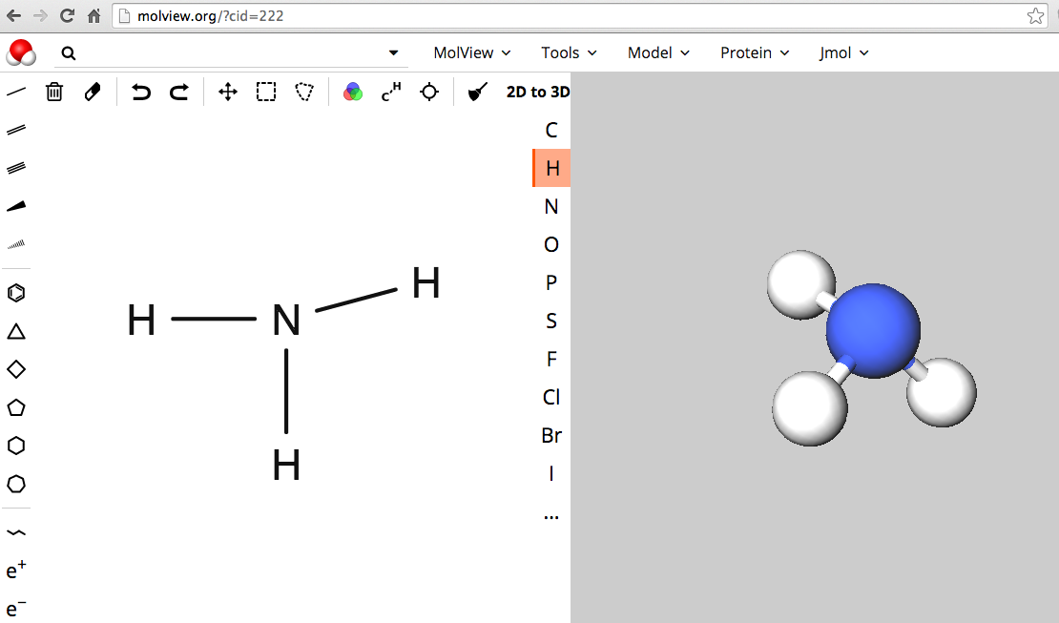
Molecular Shapes Lewis Structures
MolView: Visual On-line Molecular Modeling
http://molview.org
Bonding, Lewis Structures, Molecular Modeling:
Computational Experiments

Slide 13

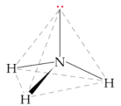
Molecular Shapes Lewis Structures
http://molview.org
optional
Name?
8
Tetra-
hedral
Trigonal
Planar
Ammonia
ethylene
Molecular Modeling: Bonding & Lewis Structures
Computational Chemistry: Molecular Modeling Report Form

Slide 14
Molecular Shapes Lewis Structures
http://molview.org
optional
Name?
8
Tetra-
hedral
Trigonal
Planar
Ammonia
ethylene
Molecular Modeling: Bonding & Lewis Structures
Computational Chemistry: Molecular Modeling Report Form

Slide 15
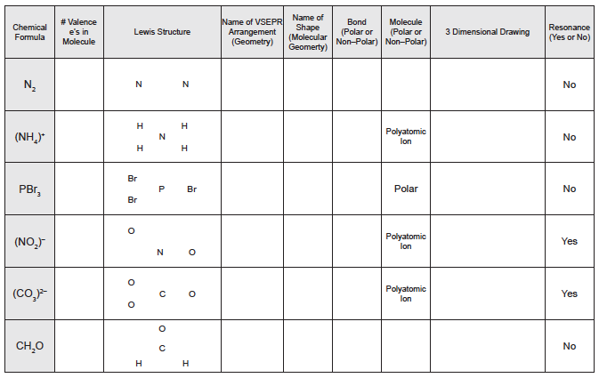
Molecular Shapes Lewis Structures
http://molview.org
Ammonium
Molecular Modeling: Bonding & Lewis Structures
Computational Chemistry: Molecular Modeling Report Form

Slide 16
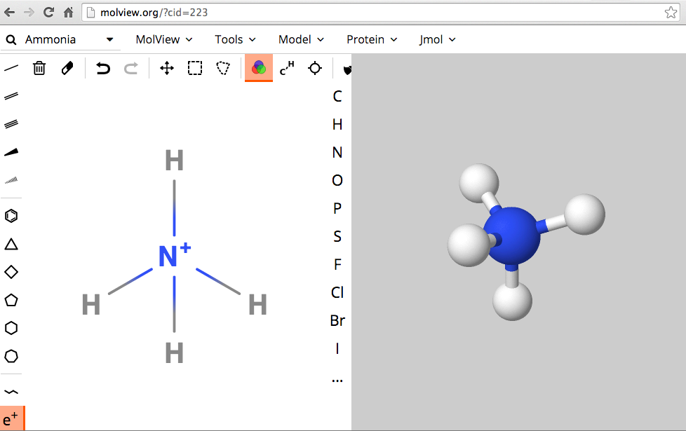
Molecular Shapes Lewis Structures
MolView: Visual On-line Molecular Modeling
http://molview.org
Ammonium
(polyatomic ion)
Molecular Modeling: Bonding & Lewis Structures
Computational Chemistry: Molecular Modeling Report Form

Slide 17
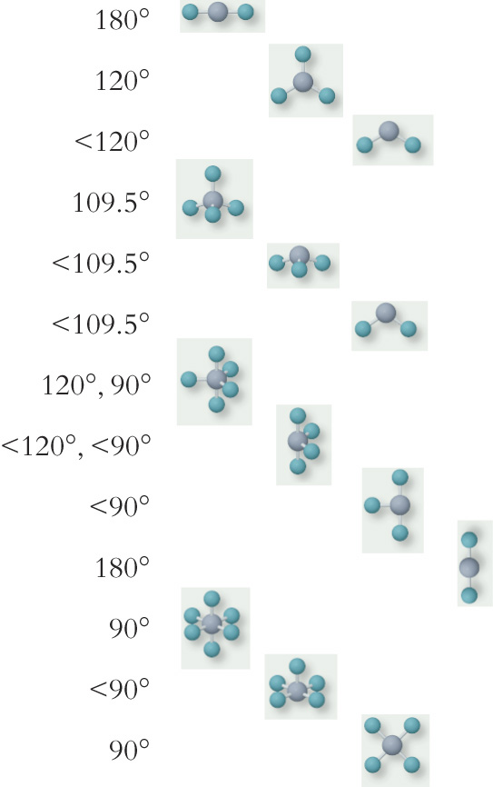
VSEPR (Electronic)
Geometry
Molecular
Geometry
Bond Angle
# of lone pairs
Important
in
Organic
Compounds
Linear Linear
Trigonal Planar Trigonal Planar
Trigonal Planar Bent
Tetrahedral Tetrahedral
Tetrahedral Trigonal Pyramidal
Tetrahedral Bent
Trigonal Bipyramidal Trigonal Bipyramidal
Trigonal Bipyramidal Seesaw
Trigonal Bipyramidal T-shape
Trigonal Bipyramidal Linear
Octahedral Octahedral
Octahedral Square Pyramidal
Octahedral Square Planar
0
0
1
0
1
2
0
1
2
3
0
1
2
See again
in
Chem 120
and possibly
in
Chem 109

Slide 18
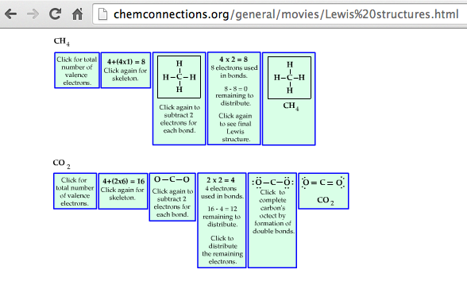
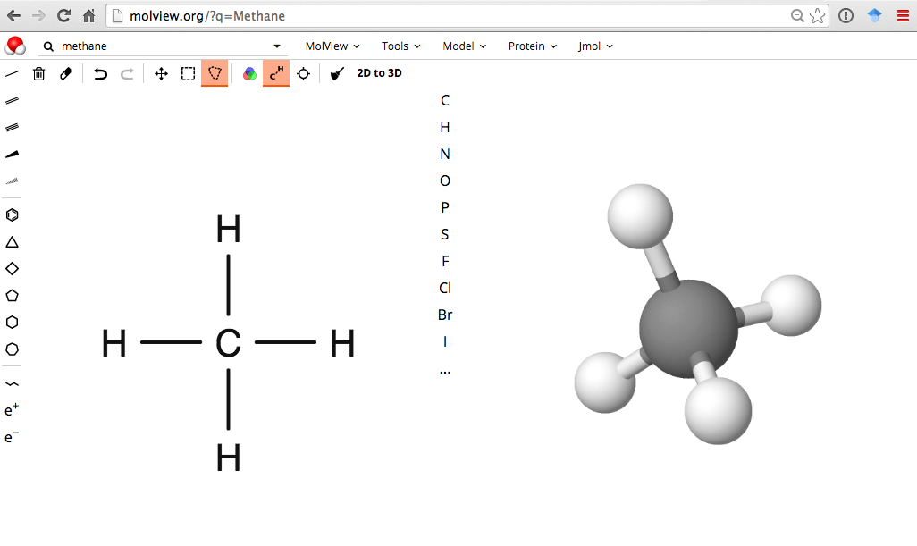
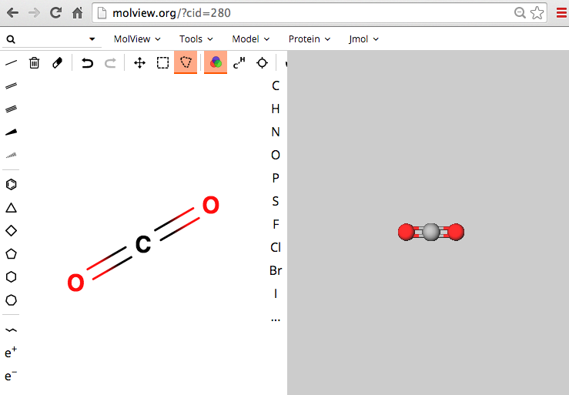
http://chemconnections.org/general/movies/Lewis%20structures.html

Slide 19
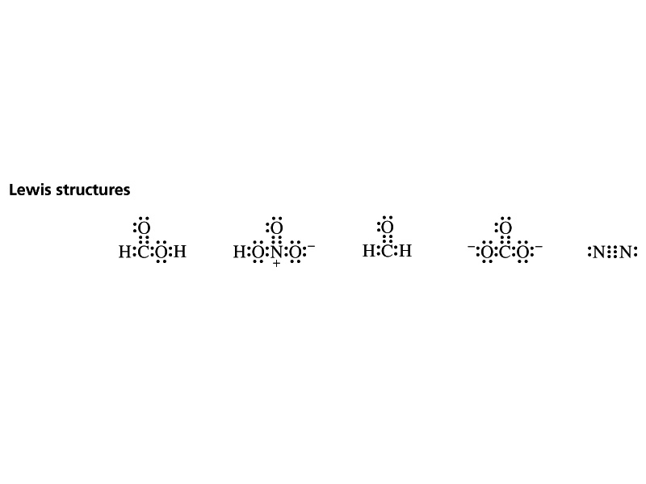
Lewis Structures / Covalent Compounds
Share valence electrons.
1 pair = 1 bond; maximum # of atom-atom bonds = 3.
Octet rule (“duet” for hydrogen)
Lewis structure examples:
Notice the “formal” charges:
In one case they balance, can you name the compound?
In the other they do not.
They both have “formal” charges. Can you name the polyatomic ion?

Slide 20
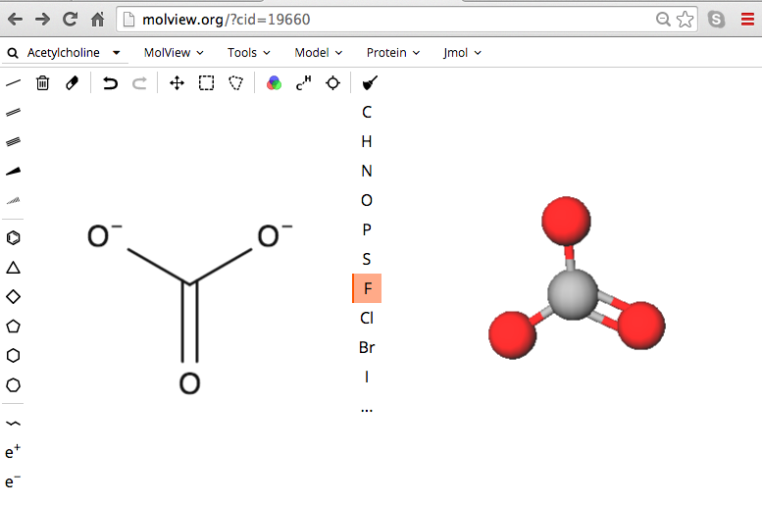
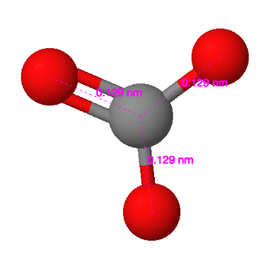
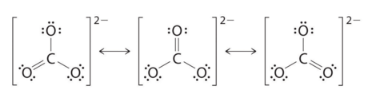
Resonance Models & Lewis Structures
MolView: Carbonate Polyatomic Ion
http://molview.org
resonance structures
Bonding, Lewis Structures, Molecular Modeling:

Slide 21
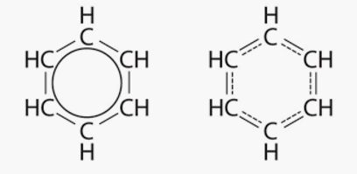
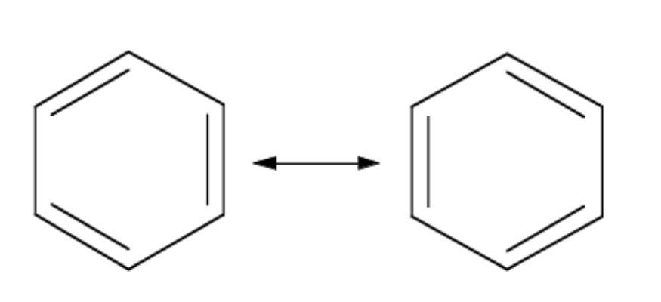
Resonance
Occurs when more than one valid Lewis structure can be written for a particular molecule. [Adjacent free electrons, double or triple bonds.]
An overall resonance structure is a weighted average of all of the possible resonance structures.

Slide 22
Question
Two resonance structures of benzene, a human carcinogen, with C-C & C=C bonds are shown below.
Which statement is incorrect?
The double headed arrow indicates that the 2 resonance structures are rapidly interchanging.
The normal bond length of a single bond is longer than a double bond.
The best resonance structure localizes the bonds so that the double bonds on the right are preferred.
The actual bond lengths in benzene are not equal to either single or double bonds.

Slide 23
Answer
Two resonance structures of benzene, a human carcinogen, with C-C & C=C bonds are shown below.
Which statement is incorrect?
The double headed arrow indicates that the 2 resonance structures are rapidly interchanging.
The normal bond length of a single bond is longer than a double bond.
The best resonance structure localizes the bonds so that the double bonds on the right are preferred.
The actual bond lengths in benzene are not equal to either single or double bonds.

Slide 24
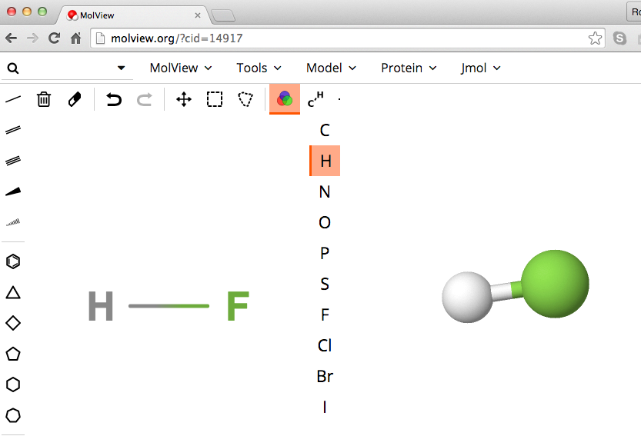
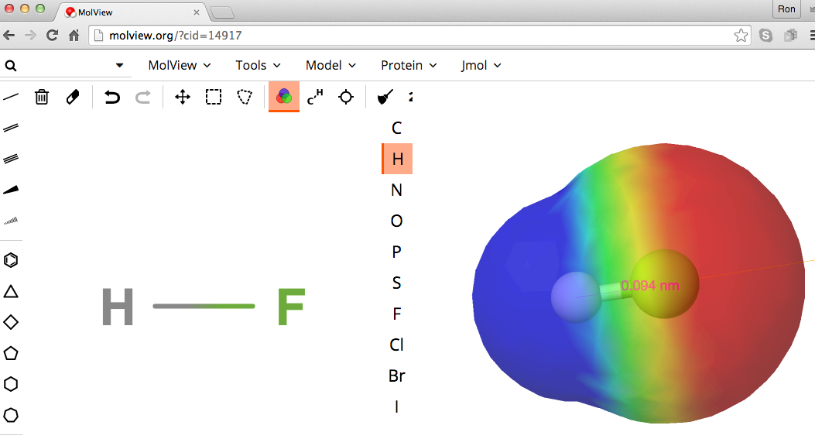
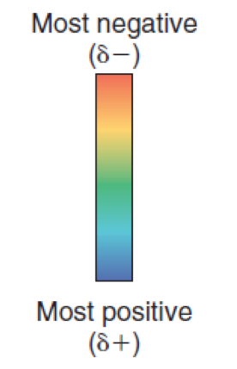
Polarity & Modeling
Polarity: Molview (http://molview.org) Jmol
Color coded electron density distribution: red-highest, blue lowest, green balanced
The more distinct the red –blue colors means the more polar the molecule.
Notes:
Figure: 08-07

Slide 25
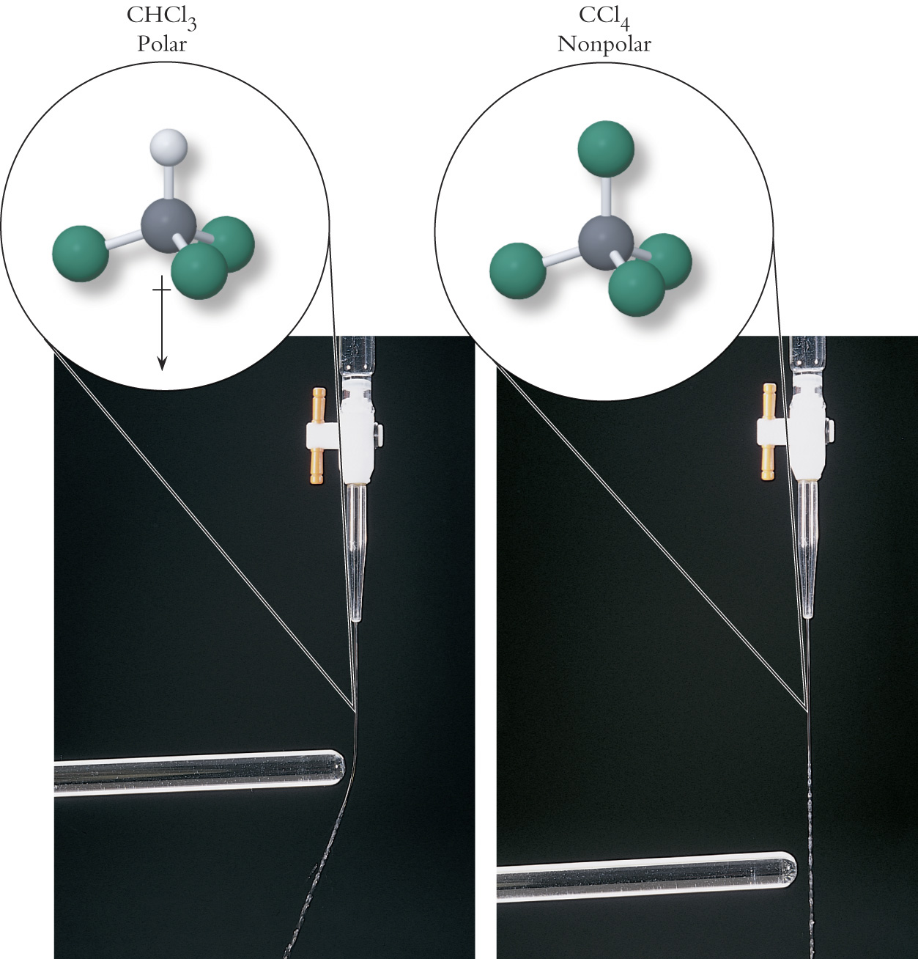
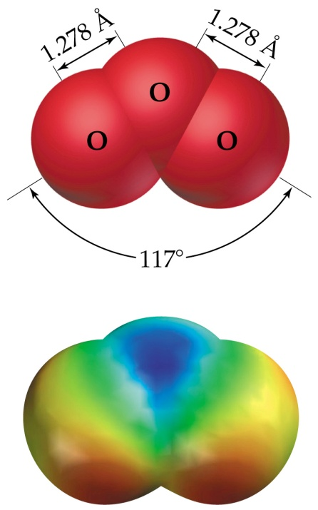
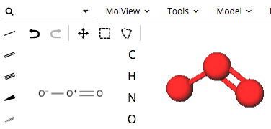
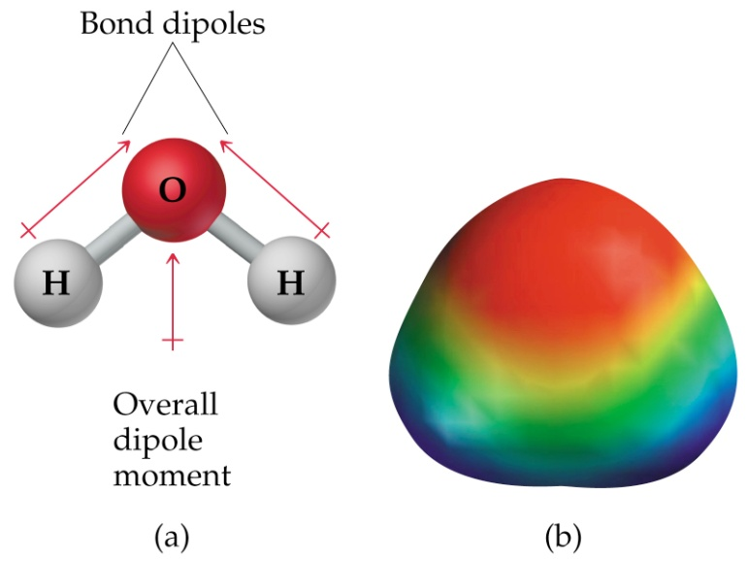


https://www.youtube.com/watch?v=ASLUY2U1M-8
Polarity & Physical Properties
Ozone, Water, & Batteries
0.1278 nm
Resultant Molecular Dipoles > 0
Solubility: Polar molecules that dissolve or are dissolved in like molecules
The Lotus flower
Water & dirt repellancy: solubility?
Notes:
New Water-Repellent Material Mimics Lotus Leaves John Roach
for National Geographic News
February 27, 2003
Dirt-repelling paint, based on the qualities of the lotus leaf, being
developed at Bonn University.

Slide 26
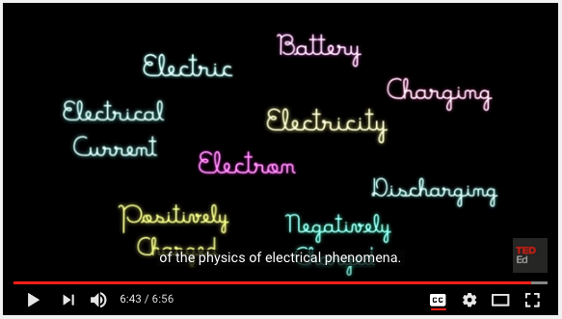
https://www.youtube.com/watch?v=MBRTR2dlwvA&t=244s

Slide 27
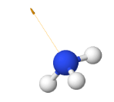
Molecular Shapes Lewis Structures
http://molview.org
optional
ammonia
8
Tetra-
hedral
Trigonal
Planar
Polar
Polar
ethylene
Molecular Modeling: Bonding & Lewis Structures
Computational Chemistry: Molecular Modeling Report Form

Slide 28
Molecular Shapes Lewis Structures
http://molview.org
optional
ammonia
8
Tetra-
hedral
Trigonal
Planar
Polar
Polar
ethylene
Molecular Modeling: Bonding & Lewis Structures
Computational Chemistry: Molecular Modeling Report Form

Slide 29
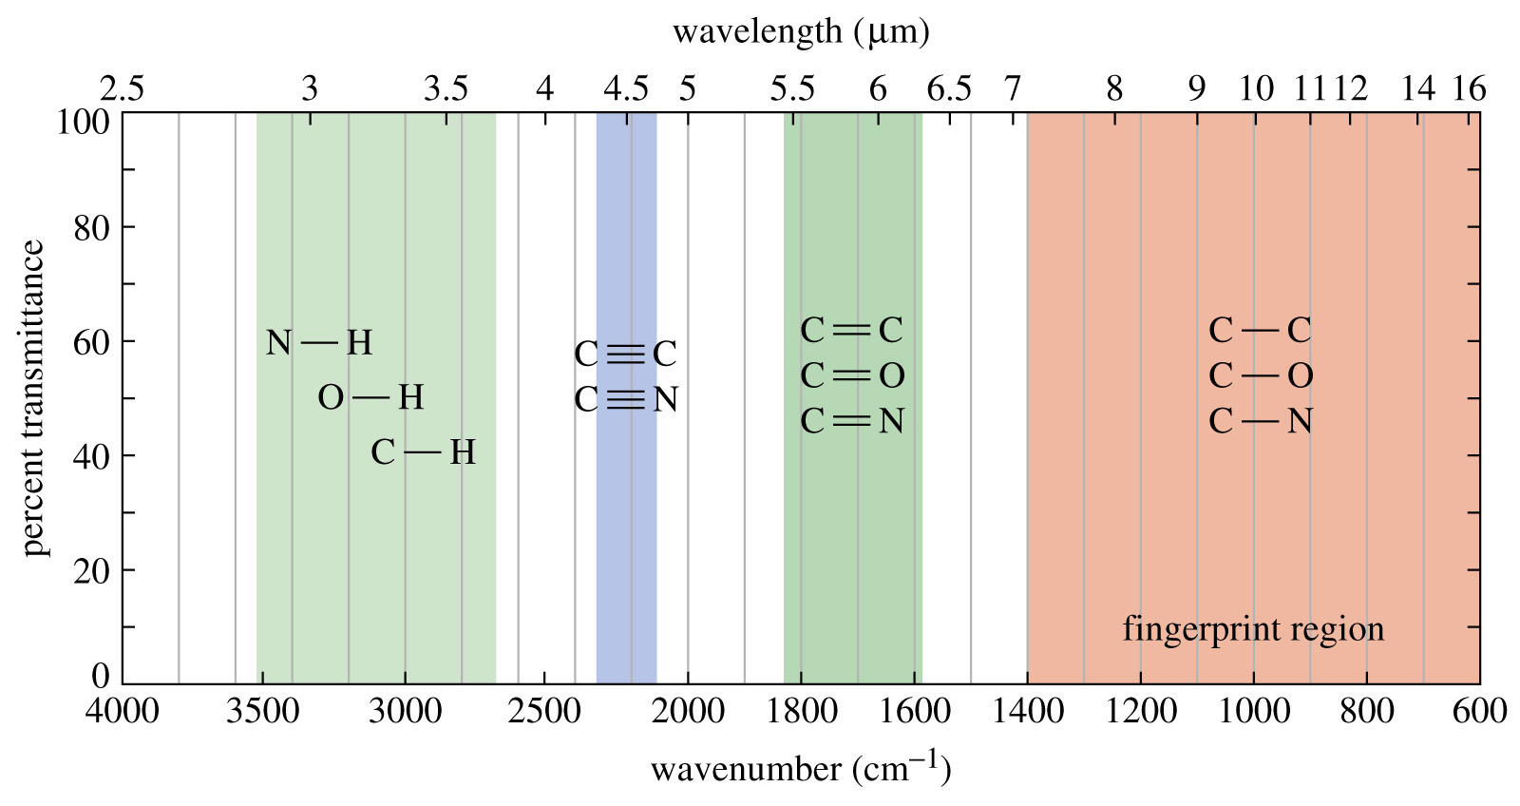
Infrared- Bond Absorbances
Invisible Molecular Motions:
https://www.youtube.com/watch?v=b0IbXG0hnOk
Notes:
Figure: 12-14-04UN
Caption:
The IR spectrum has distinct regions. The left of the spectrum shows the C-H, O-H, and N-H stretches. The triple bonds absorb around 2200 cm⁻¹ followed by the double bonds to the right at around 1700 cm⁻¹. The region below 1400 cm⁻¹ is called the fingerprint region.

Slide 30
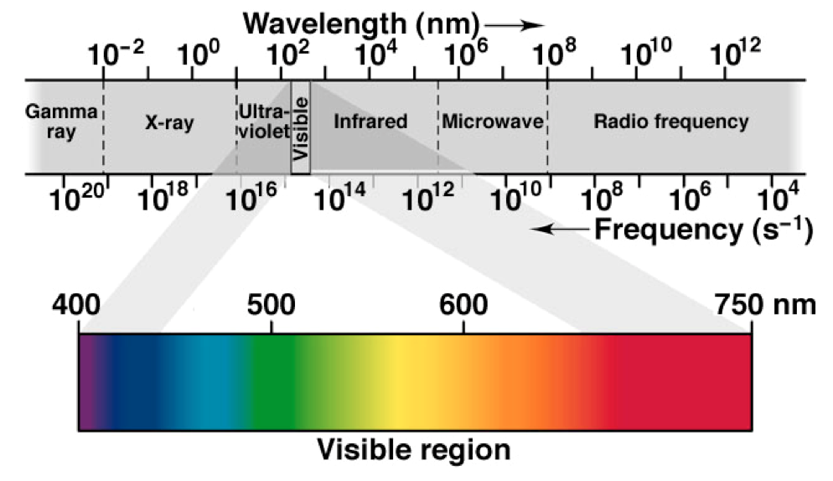
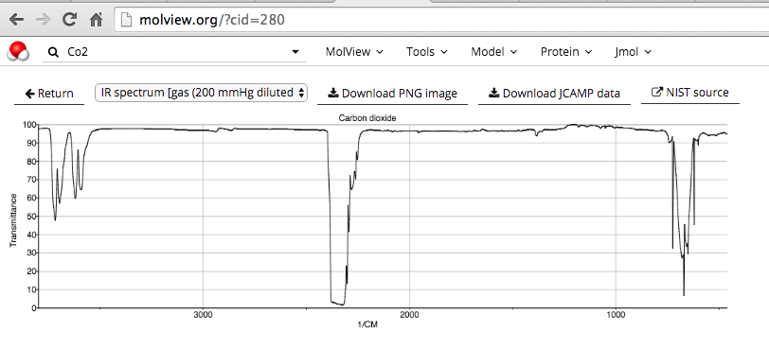

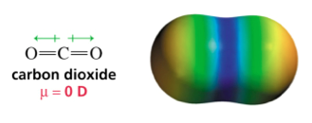
Infrared- Bond Absorbances
http://molview.org
https://www.youtube.com/watch?v=W5gimZlFY6I
Notes:
Figure: 12-14-04UN
Caption:
The IR spectrum has distinct regions. The left of the spectrum shows the C-H, O-H, and N-H stretches. The triple bonds absorb around 2200 cm⁻¹ followed by the double bonds to the right at around 1700 cm⁻¹. The region below 1400 cm⁻¹ is called the fingerprint region.

Slide 31
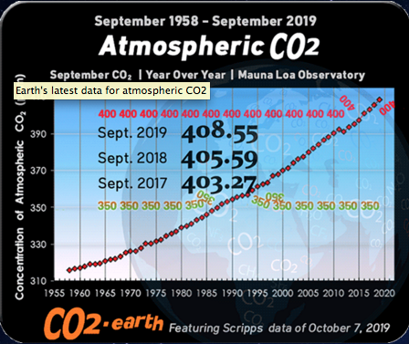
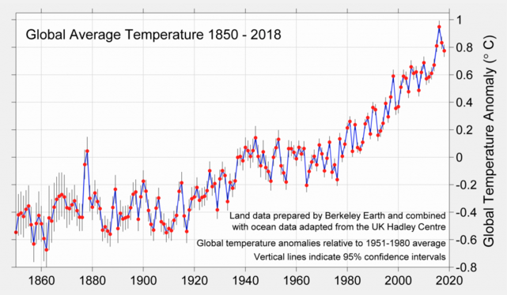
Infrared- Bond Absorbances
https://www.co2.earth/
Notes:
Figure: 12-14-04UN
Caption:
The IR spectrum has distinct regions. The left of the spectrum shows the C-H, O-H, and N-H stretches. The triple bonds absorb around 2200 cm⁻¹ followed by the double bonds to the right at around 1700 cm⁻¹. The region below 1400 cm⁻¹ is called the fingerprint region.

